Slide 1
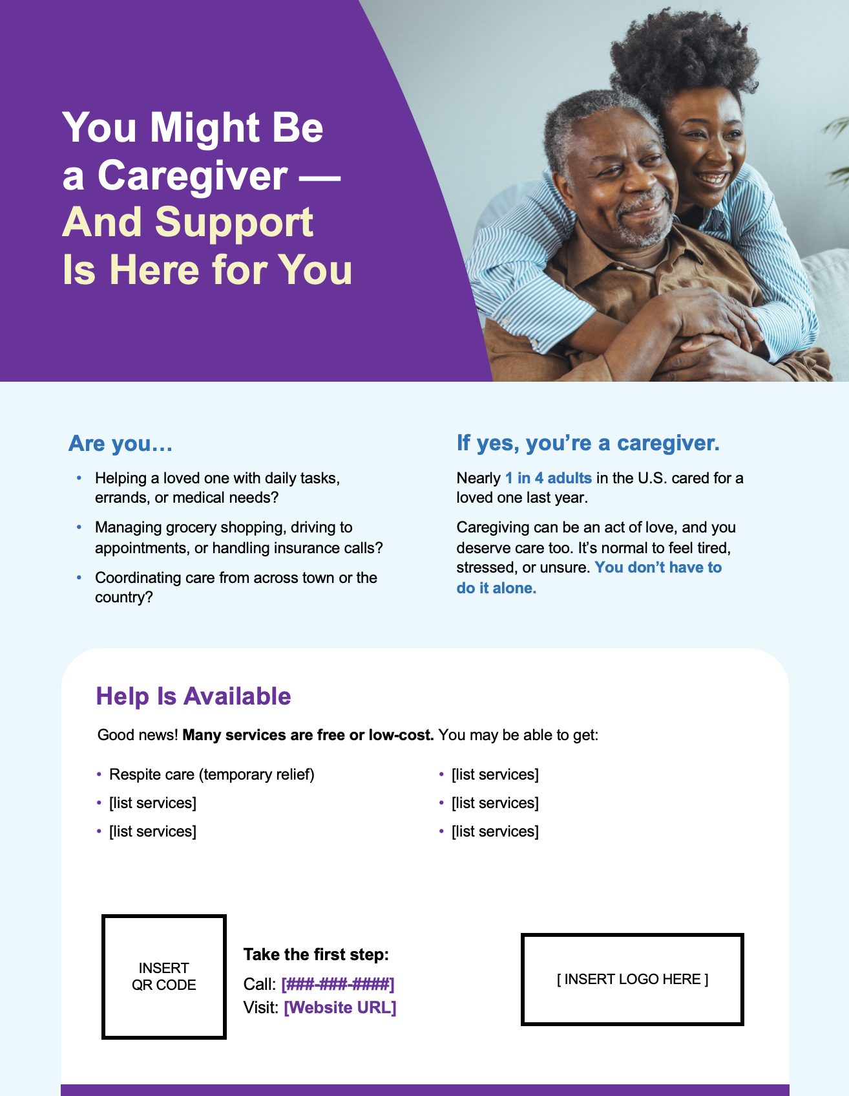
Caregivers Toolkit: Flyer (8.5x11”)
Customize with your organization's information and brand colors:
Please add the services you provide to the bulleted list.
Please remove the existing placeholders and insert your organization’s logo and a QR code.
In the space provided, enter your organization’s phone number and website URL.
Change the purple to your organization's colors by hovering over the purple box. Then, click the "Shape Fill" button and pick the relevant color. You can also change the font color.
Photography:
This file includes three slides, which show different photo options. If you’d prefer to use your own photo, the last slide is set up so that you can click on Insert Picture and add your own.
There are inexpensive stock image resources like shutterstock.com and istockphoto.com, where you can find quality photos for around $12-$33 each.
Printing:
This file includes crop marks and 0.125” bleeds for printing. Please remove all slides from the presentation except the one you intend to print. Then, follow these instructions to export it as a PDF.
PC: Select File > Export. Then select Create PDF/XPS Document, select Create PDF/XPS and Save.
MAC: Select File > Export. Then select PDF from the “File Format” list and select Best for Printing and Save.

Slide 2

You Might Be a Caregiver — And Support Is Here for You
Are you…
If yes, you’re a caregiver.
Helping a loved one with daily tasks, errands, or medical needs?
Managing grocery shopping, driving to appointments, or handling insurance calls?
Coordinating care from across town or the country?
Nearly 1 in 4 adults in the U.S. cared for a loved one last year.
Caregiving can be an act of love, and you deserve care too. It’s normal to feel tired, stressed, or unsure. You don’t have to do it alone.
Help Is Available
Good news! Many services are free or low-cost. You may be able to get:
Respite care (temporary relief)
[list services]
[list services]
[list services]
[list services]
[list services]
INSERT QR CODE
[ INSERT LOGO HERE ]
Take the first step:
Call: [###-###-####] Visit: [Website URL]

Slide 3

You Might Be a Caregiver — And Support Is Here for You
Are you…
If yes, you’re a caregiver.
Helping a loved one with daily tasks, errands, or medical needs?
Managing grocery shopping, driving to appointments, or handling insurance calls?
Coordinating care from across town or the country?
Nearly 1 in 4 adults in the U.S. cared for a loved one last year.
Caregiving can be an act of love, and you deserve care too. It’s normal to feel tired, stressed, or unsure. You don’t have to do it alone.
Help Is Available
Good news! Many services are free or low-cost. You may be able to get:
Respite care (temporary relief)
[list services]
[list services]
[list services]
[list services]
[list services]
INSERT QR CODE
[ INSERT LOGO HERE ]
Take the first step:
Call: [###-###-####] Visit: [Website URL]

Slide 4

You Might Be a Caregiver — And Support Is Here for You
Are you…
If yes, you’re a caregiver.
Helping a loved one with daily tasks, errands, or medical needs?
Managing grocery shopping, driving to appointments, or handling insurance calls?
Coordinating care from across town or the country?
Nearly 1 in 4 adults in the U.S. cared for a loved one last year.
Caregiving can be an act of love, and you deserve care too. It’s normal to feel tired, stressed, or unsure. You don’t have to do it alone.
Help Is Available
Good news! Many services are free or low-cost. You may be able to get:
Respite care (temporary relief)
[list services]
[list services]
[list services]
[list services]
[list services]
INSERT QR CODE
[ INSERT LOGO HERE ]
Take the first step:
Call: [###-###-####] Visit: [Website URL]

Slide 5
You Might Be a Caregiver — And Support Is Here for You
Are you…
If yes, you’re a caregiver.
Helping a loved one with daily tasks, errands, or medical needs?
Managing grocery shopping, driving to appointments, or handling insurance calls?
Coordinating care from across town or the country?
Nearly 1 in 4 adults in the U.S. cared for a loved one last year.
Caregiving can be an act of love, and you deserve care too. It’s normal to feel tired, stressed, or unsure. You don’t have to do it alone.
Help Is Available
Good news! Many services are free or low-cost. You may be able to get:
Respite care (temporary relief)
[list services]
[list services]
[list services]
[list services]
[list services]
INSERT QR CODE
[ INSERT LOGO HERE ]
Take the first step:
Call: [###-###-####] Visit: [Website URL]

